Slide 1
Channel TPV Analysis
Plan vs Actual · 2025 & 2026 YTD
mercado pago
Mar'26
FP&A
Channels: CANAIS DIGITAIS · FDV PROPRIA · FDV TERCEIRA MGM · PARTNERS ONLINE · RESELLERS · TELEVENDAS

Slide 2
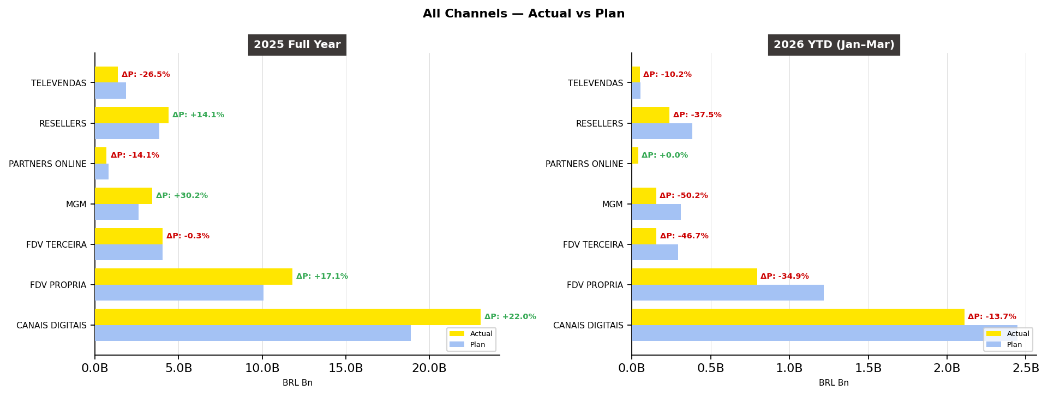
Summary | All Channels — Actual vs Plan | Mar'26
Managerial
LC
BRAZIL

Slide 3
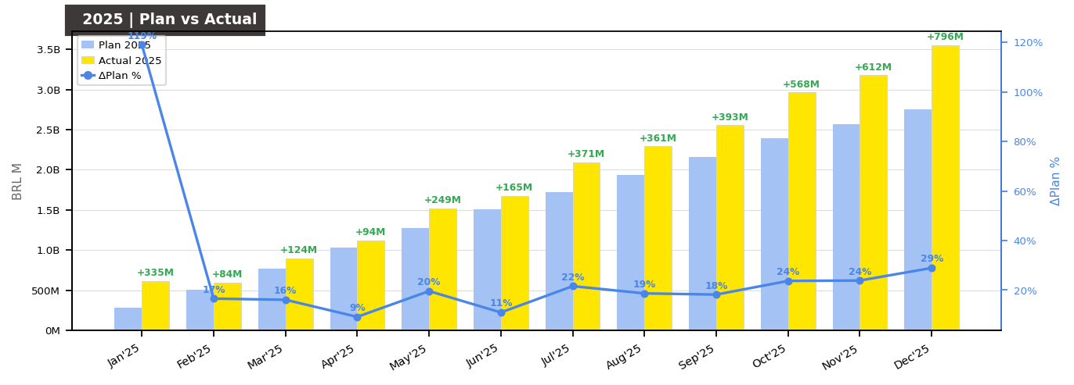
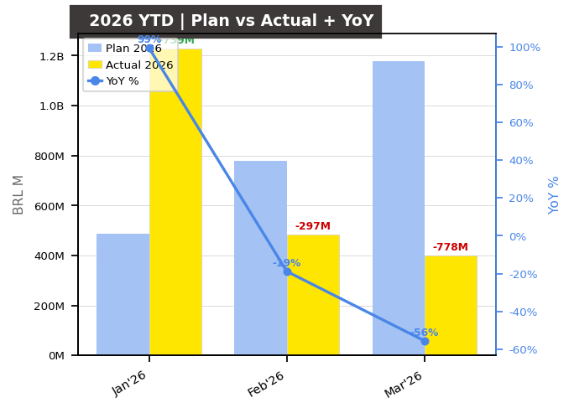
CANAIS DIGITAIS | TPV Evolution | Mar'26
Managerial
LC
BRAZIL
2025 Full Year — Actual vs Plan
2026 YTD Jan–Mar — Actual vs Plan
Jan'26 — Actual vs Plan
Feb'26 — Actual vs Plan
Mar'26 — Actual vs Plan
23.1B
2.1B
1.2B
483M
399M
vs Plan: +22.0%
vs Plan: -13.7%
vs Plan: +151.3%
vs Plan: -38.1%
vs Plan: -66.1%
YoY: +0.0%
YoY: +99.3%
YoY: -18.8%
YoY: -55.6%
* Feb'26 and Mar'26 actuals include M0 lifecycle only (M1/TRIANGLE data pending processing). Plan 2026 Jan includes M0 only per cohort model.

Slide 4
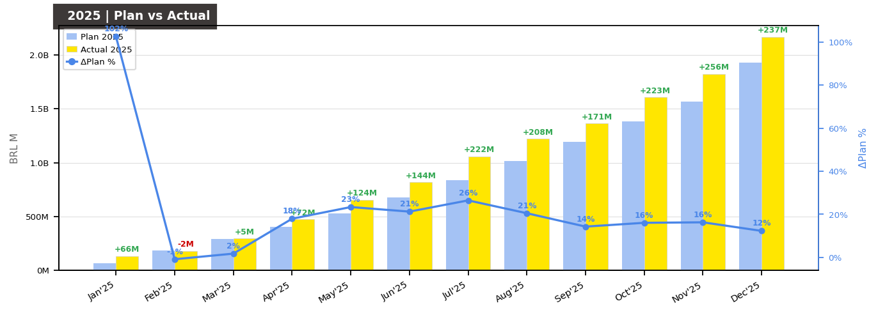
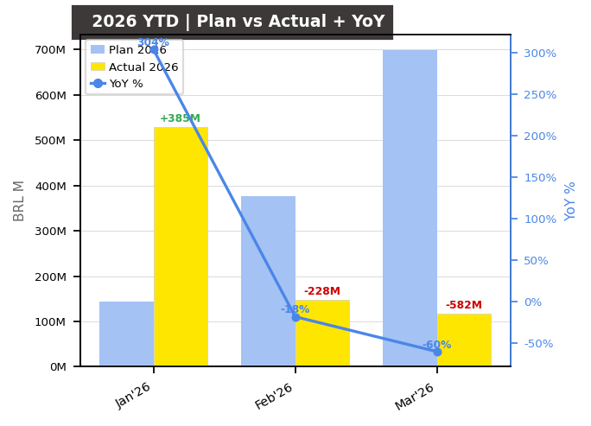
FDV PROPRIA | TPV Evolution | Mar'26
Managerial
LC
BRAZIL
2025 Full Year — Actual vs Plan
2026 YTD Jan–Mar — Actual vs Plan
Jan'26 — Actual vs Plan
Feb'26 — Actual vs Plan
Mar'26 — Actual vs Plan
11.8B
794M
529M
148M
117M
vs Plan: +17.1%
vs Plan: -34.9%
vs Plan: +267.8%
vs Plan: -60.7%
vs Plan: -83.3%
YoY: +30.8%
YoY: +303.9%
YoY: -18.3%
YoY: -60.3%
* Feb'26 and Mar'26 actuals include M0 lifecycle only (M1/TRIANGLE data pending processing). Plan 2026 Jan includes M0 only per cohort model.

Slide 5
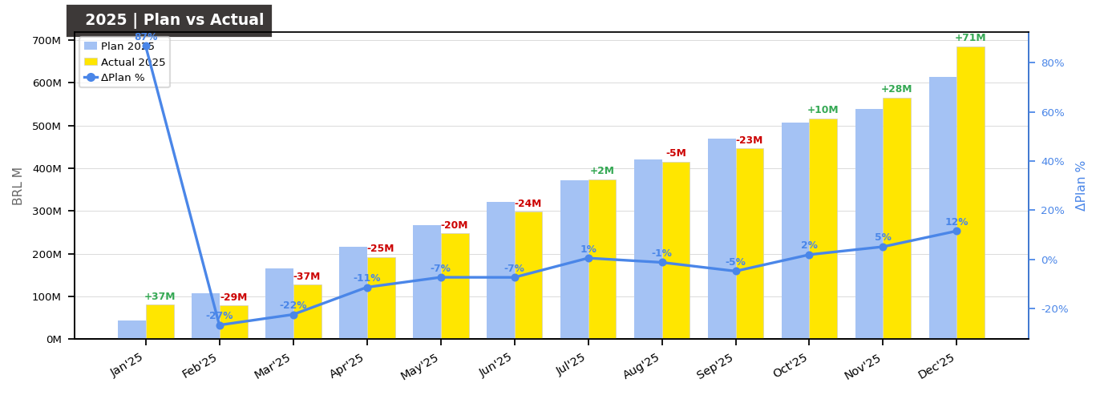
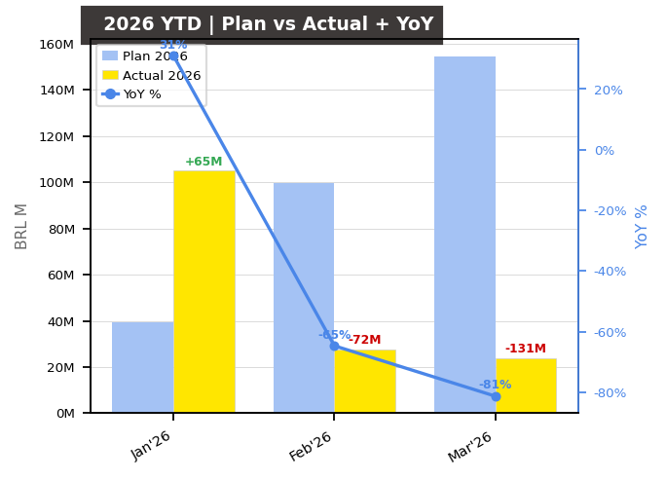
FDV TERCEIRA | TPV Evolution | Mar'26
Managerial
LC
BRAZIL
2025 Full Year — Actual vs Plan
2026 YTD Jan–Mar — Actual vs Plan
Jan'26 — Actual vs Plan
Feb'26 — Actual vs Plan
Mar'26 — Actual vs Plan
4.0B
157M
105M
28M
24M
vs Plan: -0.3%
vs Plan: -46.7%
vs Plan: +165.5%
vs Plan: -72.2%
vs Plan: -84.5%
YoY: -45.3%
YoY: +31.0%
YoY: -64.7%
YoY: -81.3%
* Feb'26 and Mar'26 actuals include M0 lifecycle only (M1/TRIANGLE data pending processing). Plan 2026 Jan includes M0 only per cohort model.

Slide 6

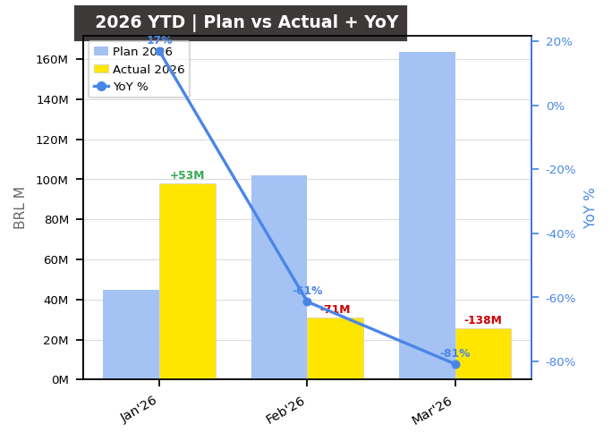
MGM | TPV Evolution | Mar'26
Managerial
LC
BRAZIL
2025 Full Year — Actual vs Plan
2026 YTD Jan–Mar — Actual vs Plan
Jan'26 — Actual vs Plan
Feb'26 — Actual vs Plan
Mar'26 — Actual vs Plan
3.4B
154M
98M
31M
26M
vs Plan: +30.2%
vs Plan: -50.2%
vs Plan: +119.5%
vs Plan: -69.7%
vs Plan: -84.4%
YoY: -48.0%
YoY: +16.9%
YoY: -61.4%
YoY: -80.8%
* Feb'26 and Mar'26 actuals include M0 lifecycle only (M1/TRIANGLE data pending processing). Plan 2026 Jan includes M0 only per cohort model.

Slide 7
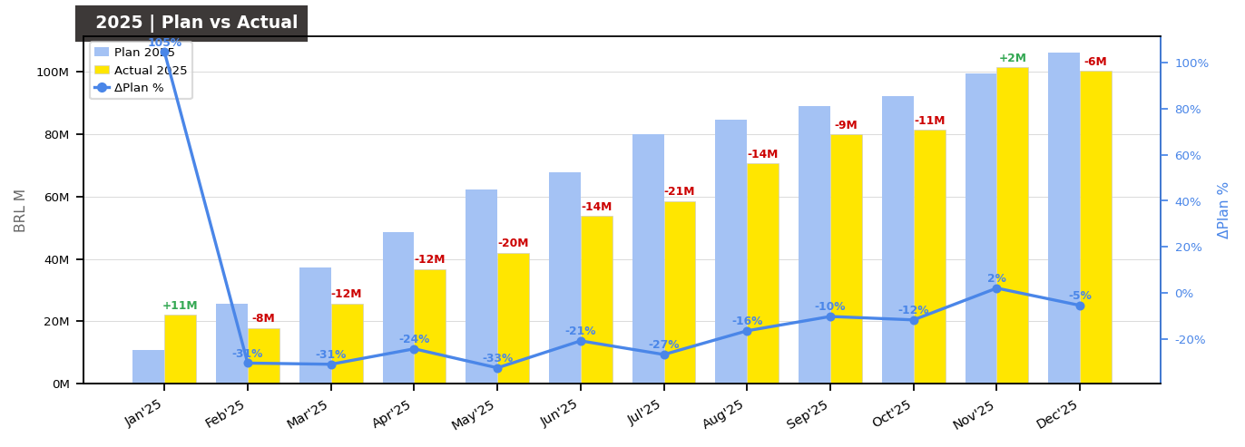
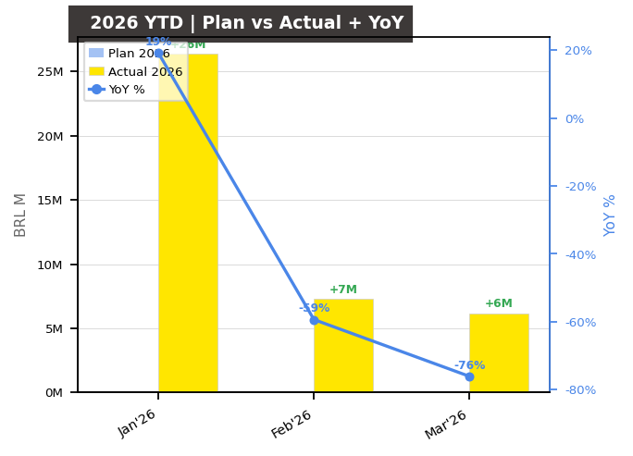
PARTNERS ONLINE | TPV Evolution | Mar'26
Managerial
LC
BRAZIL
2025 Full Year — Actual vs Plan
2026 YTD Jan–Mar — Actual vs Plan
Jan'26 — Actual vs Plan
Feb'26 — Actual vs Plan
Mar'26 — Actual vs Plan
690M
40M
26M
7M
6M
vs Plan: -14.1%
vs Plan: +0.0%
vs Plan: +0.0%
vs Plan: +0.0%
vs Plan: +0.0%
YoY: -39.4%
YoY: +19.2%
YoY: -59.3%
YoY: -76.1%
* Feb'26 and Mar'26 actuals include M0 lifecycle only (M1/TRIANGLE data pending processing). Plan 2026 Jan includes M0 only per cohort model.

Slide 8
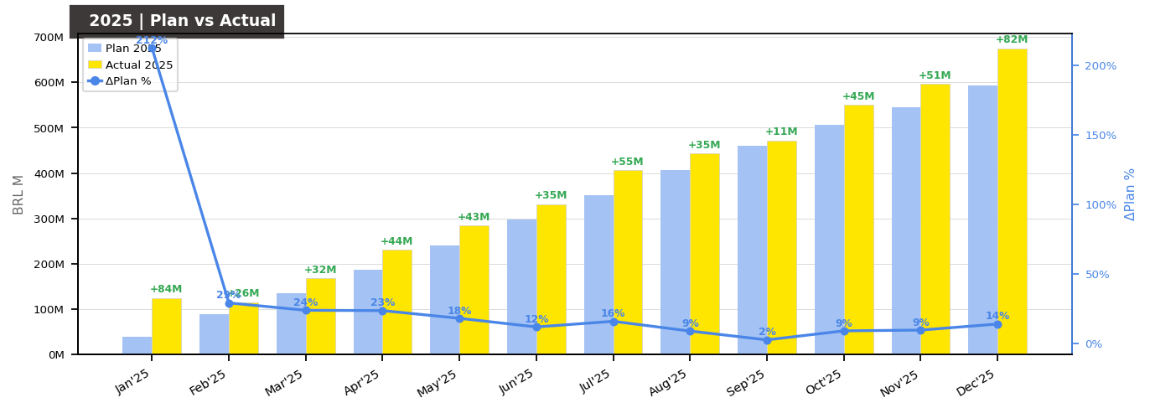
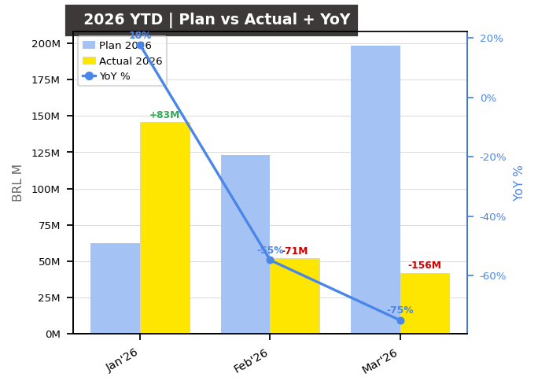
RESELLERS | TPV Evolution | Mar'26
Managerial
LC
BRAZIL
2025 Full Year — Actual vs Plan
2026 YTD Jan–Mar — Actual vs Plan
Jan'26 — Actual vs Plan
Feb'26 — Actual vs Plan
Mar'26 — Actual vs Plan
4.4B
240M
146M
52M
42M
vs Plan: +14.1%
vs Plan: -37.5%
vs Plan: +134.1%
vs Plan: -57.8%
vs Plan: -78.8%
YoY: -41.1%
YoY: +17.6%
YoY: -54.8%
YoY: -75.0%
* Feb'26 and Mar'26 actuals include M0 lifecycle only (M1/TRIANGLE data pending processing). Plan 2026 Jan includes M0 only per cohort model.

Slide 9
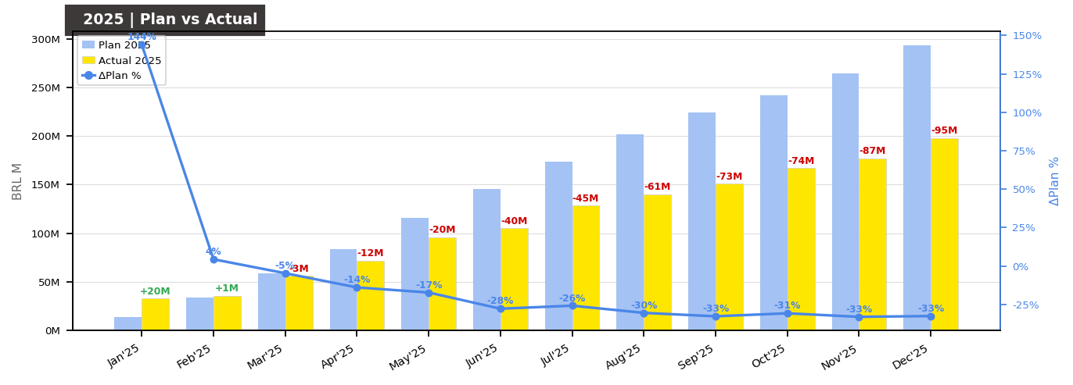
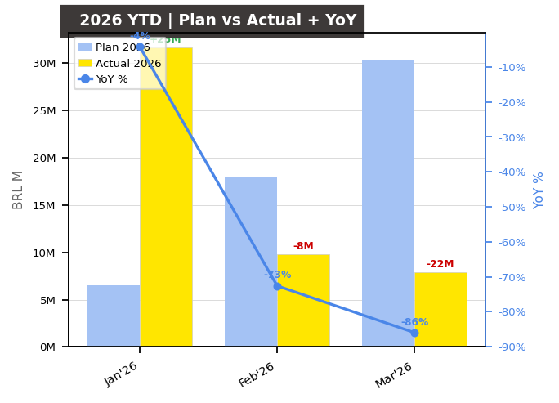
TELEVENDAS | TPV Evolution | Mar'26
Managerial
LC
BRAZIL
2025 Full Year — Actual vs Plan
2026 YTD Jan–Mar — Actual vs Plan
Jan'26 — Actual vs Plan
Feb'26 — Actual vs Plan
Mar'26 — Actual vs Plan
1.4B
49M
32M
10M
8M
vs Plan: -26.5%
vs Plan: -10.2%
vs Plan: +384.8%
vs Plan: -45.8%
vs Plan: -74.1%
YoY: -60.5%
YoY: -4.2%
YoY: -72.6%
YoY: -86.0%
* Feb'26 and Mar'26 actuals include M0 lifecycle only (M1/TRIANGLE data pending processing). Plan 2026 Jan includes M0 only per cohort model.

